Slide 1
GGVIS for R Tutorial
By Leslie McIntosh & Connie Zabarovskaya

Slide 2
About ggvis
This ggvis tutorial is based on the notes on the following link, written by Hadley Wickham: http://ggvis.rstudio.com/ggvis-basics.html
GGVIS allows for interactive graphics in R, which makes exploration of data much easier
Plot data in just a few lines of code
Outside of RStudio, graphics will be rendered in a web browser.

Slide 3
Installation
Download and Install R:
http://cran.wustl.edu/
Install RStudio
https://www.rstudio.com/ide/
Install ggvis: ggvis is not yet (24 May 2014) available on CRAN. So it needs to be installed from GitHub using the following code:
> install.packages("devtools")
> devtools::install_github(c("rstudio/shiny", "rstudio/ggvis"),
build_vignettes = FALSE)
load ggvis library:
> library("ggvis")

Slide 4
Simple ggvis() Call
call to ggvis
> p<- ggvis(mtcars, x = ~wt, y = ~mpg, …)
to actually plot (display) the data
> layer_points(p)
name of plot
data set
var from data set for x-axis
var from data set for y-axis
other elements, if any

Slide 5
ggvis() Call Using ‘Pipe’
use ‘pipe’* - %>% - to avoid nested functions and “temporary” variables.
> mtcars %>%
ggvis(x = ~wt, y = ~mpg) %>%
layer_points()
OR
> mtcars %>%
ggvis(~wt, ~mpg) %>%
layer_points()
%>% takes value on the left-hand side and passes it to function or expression on the right-hand side
*Pipe comes from the magrittr package (http://cran.r-project.org/web/packages/magrittr/magrittr.pdf)
Data set
ggvis() call
plot call
pipe
into
pipe
into
Notes:
OR, both expressions can be used equivalently, as the first two arguments in ggvis() call are typically the positions.
# (Although, I prefer to explicitly state the x & y as in the previous code)
NOTES: The %>% (called 'pipe') from the margrittr packaged (http://cran.r-project.org/web/packages/magrittr/magrittr.pdf)
# allows to write more readable code, which is especially helpful when nested code.
# "The semantics of magrittr yield clean and readable code which can be read from
# left to right, rather than from the inside and out (which is the case with nested function calls), and
# reduce the need for temporary value bindings."

Slide 6
ggvis() Call Using ‘Pipe’ (Cont’d)
Using %>% (‘pipe’) also allows you to seamlessly intermingle ggvis and dplyr code
> library(dplyr)
> mtcars %>%
ggvis(x = ~mpg, y = ~disp) %>%
mutate(disp = disp / 61.0237) %>%
# convert engine displacement to liters
layer_points()

Slide 7
Visual Properties & Adding More Variables
Other variables can be added using 'fill', 'stroke', 'size', and 'shape‘ > mtcars %>% ggvis(x=~wt, y=~mpg, fill= ~gear) %>% layer_points()
To fix elements (e.g., color, opacity, size, shape, stroke) use ‘:=‘ instead of ‘=‘ > mtcars %>% ggvis(x=~wt, y=~mpg, fill= ~gear, opacity := 0.5, size := 300) %>%
layer_points()

Slide 8
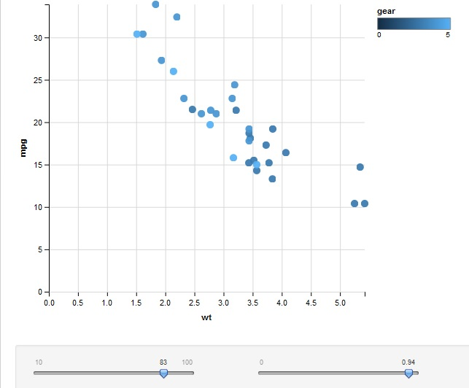
Interaction with ggvis(). Example 1
To make graphs interactive - connect variables to interactive controls (sliders, drop-down menus, text-boxes, radio buttons, etc.)
> mtcars %>%
ggvis(~wt, ~mpg, fill= ~gear,
size := input_slider(10, 100),
opacity := input_slider(0, 1)) %>%
layer_points()

Slide 9
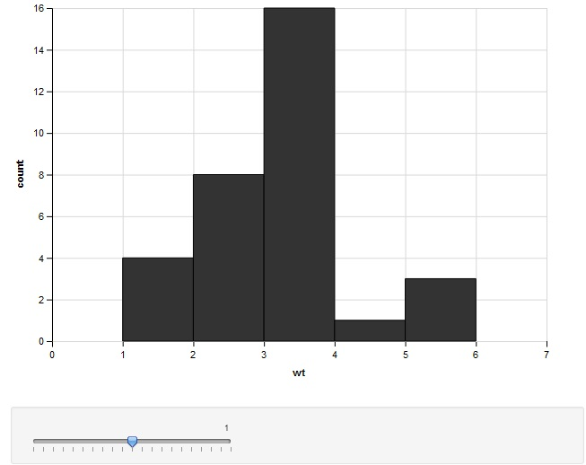
Interaction with ggvis(). Example 2
Interactive Controls available:
input_slider(),
input_select() (dropdown menu)
input_checkbox(),
input_checkboxgroup() (multiple choice),
input_radiobuttons(),
input_text() and input_numeric() (only numerical input),
Use “=“ when assigning interactive controls to a var, “:=“ is used only for static values
Example with a Histogram
> mtcars %>%
ggvis(~wt) %>%
layer_histograms(binwidth = input_slider(0, 2, step = 0.1))

Slide 10
Layer Options in ggvis()
Other layer options, besides layer_points() and layer_histograms():
layer_bars()
layer_ribbons() (filled space between two paths or a path and an axis)
layer_paths() (all points connected with a line)
layer_lines() (equivalent to arrange(x) %>% layer_paths())
layer_smooths() (displays predictions with a line)
layer_rects() (rectangles)
layer_text() (displays text on the chart)
To display multiple layers on one chart – pipe (%>%) them into each other, but include individual parameters (fill, size, span, etc.) inside their parentheses, instead of ggvis() (see slide 12)

Slide 11
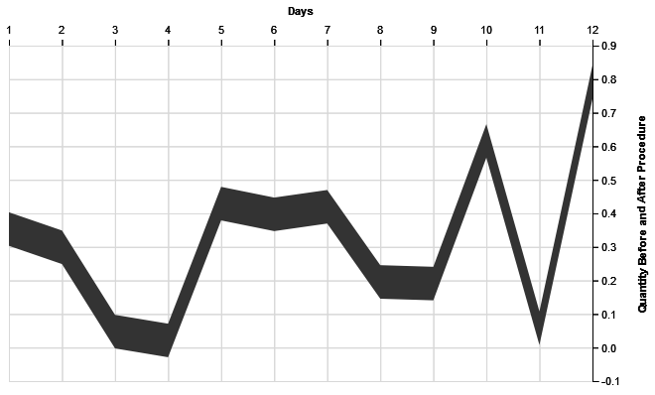
Layer_ribbons() with Axis Formatting
3
Without y2 in ggvis() call (values are different due to runif())
4
1
5
2
> df <- data.frame(x = 1:12, y = runif(12))
df %>% ggvis(x = ~x, y = ~y, y2 = ~y - 0.1) %>% layer_ribbons() %>%
add_guide_axis("x", title = "Days", orient = "top") %>%
add_guide_axis("y", title = "Quantity Before and After Procedure", orient = "right", title_offset = 50)
1
2
3
4
5

Slide 12
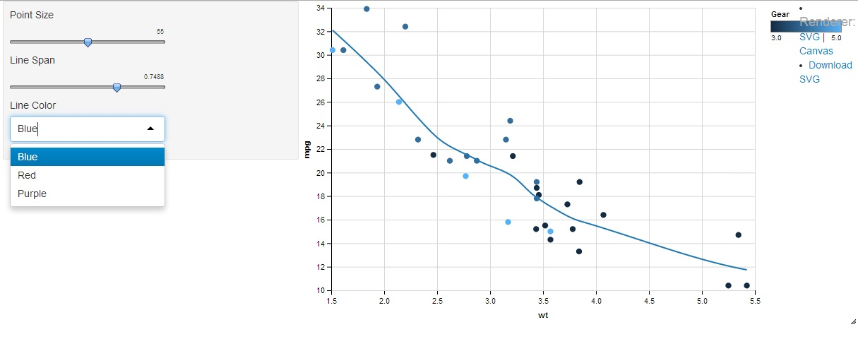
Multiple Layers & Interaction
> mtcars %>%
ggvis(~wt, ~mpg) %>%
layer_points(fill = ~gear, size := input_slider(10, 100, label = "Point Size")) %>%
layer_smooths(stroke = input_select(choices = c("Blue" = "blue", "Red" = "red", "Purple" = "purple"),selected = "Blue", label = "Line Color"), span = input_slider(0.2, 1, value = 0.75, label = "Line Span")) %>%
add_guide_legend( fill = "fill", title = "Gear", stroke = "stroke")
1
3
5
2
7
6
4
4
5
3
6
7
NOTE: ‘fill = ~gear’ could be included into the ggvis() call, instead of layer call
2
1

Slide 13
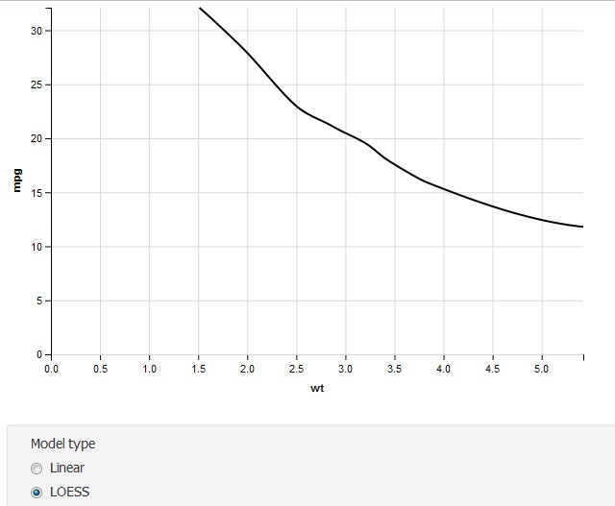
Interaction with ggvis(). Example 3
Example with Prediction Model and radio buttons
> mtcars %>%
ggvis(~wt, ~mpg) %>%
layer_model_predictions(model = input_radiobuttons(
choices = c("Linear" = "lm", "LOESS" = "loess"),
selected = "loess",
label = "Model type"))

Slide 14
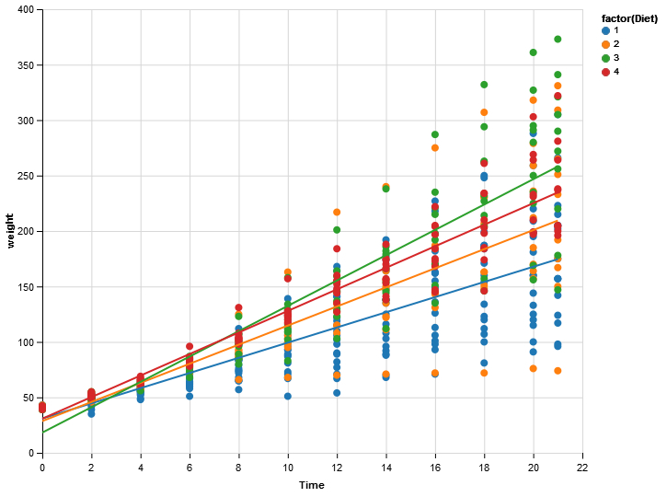
Grouping Variables and Smoothers
> ChickWeight %>%
ggvis(x = ~Time, y = ~weight, fill = ~factor(Diet)) %>%
layer_points() %>%
group_by(Diet) %>%
layer_model_predictions(model="lm", stroke = ~factor(Diet))

Slide 15
More Resources on ggvis()
http://ggvis.rstudio.com/
http://ggvis.rstudio.com/cookbook.html
http://ggvis.rstudio.com/interactivity.html

Slide 16
Thank you! Questions?

